Slide 1
Calculating Employment Income for Child Support
How to calculate monthly gross income from employment

Slide 2
Objectives 🎯
- Identify types of employment pay periods
1
- Accurately convert earnings into gross monthly income
2
- Distinguish bi-weekly vs. semi-monthly pay
3
- Calculate YTD average monthly income
4
- Handle seasonal or intermittent employment
5

Slide 3
Conversion Table 🧮
Weekly: $ amount × 4.333
Bi-Weekly: $ amount × 2.166
Semi-Monthly: $ amount × 2
Monthly: Use as-is
Quarterly: $ amount ÷ 3
Annually: $ amount ÷ 12

Slide 4
Bi-Weekly vs. Semi-Monthly 🧭
Bi-Weekly: 26 checks/year
Semi-Monthly: 24 checks/year
Key Difference:
$2,000 bi-weekly → $4,333.33/month
$2,000 semi-monthly → $4,000/month

Slide 5
Weekly Pay Example 📊
Traditional Method:
$950 × 52 ÷ 12 = $4,116.67/month
Quick Multiplier:
$950 × 4.333 = $4,116.35/month

Slide 6
Seasonal Income 🌦️
Income must be annualized.
Example:
$500/week × 10 weeks = $5,000
$5,000 ÷ 12 = $416.67/month

Slide 7
Standard YTD Income Calculation 🧾 When the employee worked the full year (from Jan 1):
Step One
Calculate the per diem rate
Obtain the gross year-to-date (YTD) income from your pay stub.
Calculate the total number of calendar days from January 1 to the end date of the pay period.
Divide the YTD income by this total number of days to find the Daily Rate.
Step Two
Determine Annual Income
Multiply the Daily Rate by 365 (or 366 in a leap year) to determine the Annual Income.
Step Three
Determine average monthly gross income
Divide the Annual Income by 12 to arrive at the Monthly Income.

Slide 8
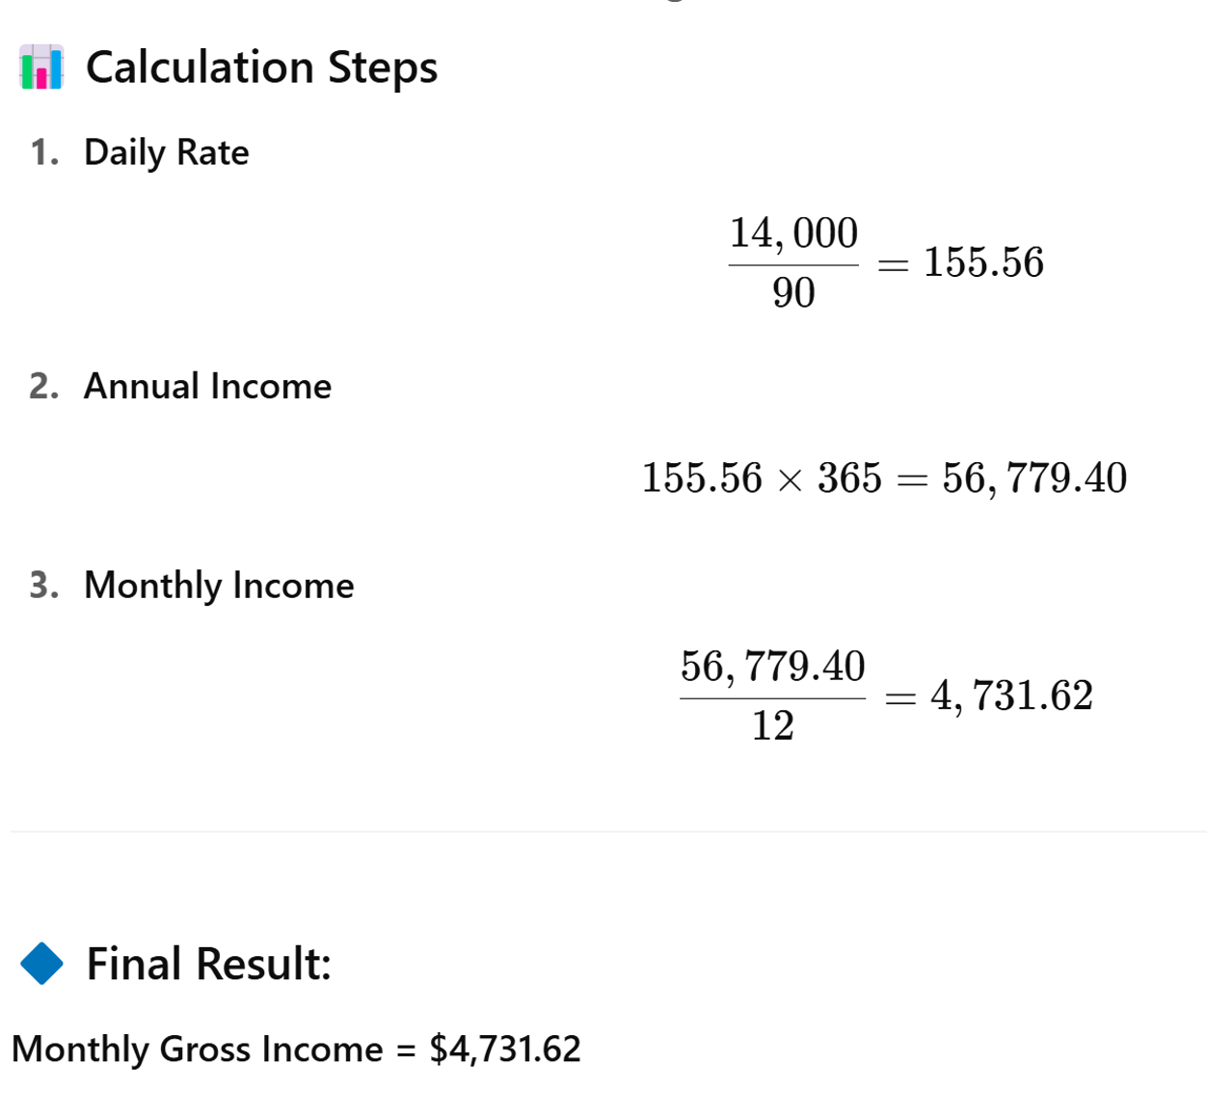
Example: Pay Period Ending: March 31, 2025 YTD Earnings: $14000
-

Slide 9
Start Date: Feb 10, 2025 End Date: July 18, 2025 Y-T-D Earnings: $21,500
YTD First Date other than January 1st:
Day Count = 159
2/10/2025 = Day 41
7/18/2025 = Day 199
199 – 41 = 158
158 + 1 = 159
- Daily Rate = $21,500 ÷ 159 = $135.22
- Annual Income = $135.22 × 365 = $49,355.30
- Monthly Income = $49,355.30 ÷ 12 = $4,112.94
Reason for Adding One: Count every day including the start date and end date
Check out: Date to Date Calculator on timeanddate.com

Slide 10
Day Number Tools 📅
Helpful Links:
Time and Date: Date to Date Calculator
Omni Calculator: Date to Date Calculator
Epoch Converter: Day Numbers

Slide 11
High-Level Summary 📌
- Proper conversion based on pay period
- Bi-weekly vs. semi-monthly matters
- 4.333 multiplier for quick weekly calc
- YTD for irregular incomes
- Seasonal income annualized

Slide 12
Test Your Knowledge

Slide 13
Exercise 1: Standard YTD (Full-Year Employment)
Scenario:
Parent’s YTD gross income = $13,000
Pay stub ends on April 30, 2025
What is the monthly income?

Slide 14
Exercise 1: Standard YTD – Answer Key ✅
Scenario:
YTD Gross Income = $13,000
Pay Stub End Date = April 30, 2025 (Day 120)
Employment assumed from Jan 1 (Full-Year)
Steps:
1. Daily Rate = $13,000 ÷ 120 = $108.33
2. Annual Income = $108.33 × 365 = $39,541.67
3. Monthly Income = $39,541.67 ÷ 12 = $3,295.14
✔ Final Answer: $3,295.14/month

Slide 15
Exercise 2: Spot the Error Challenge
Scenario:
Parent began work on February 15, 2025
Pay stub ends August 15, 2025
YTD gross income = $25,000
A staff member calculated:
Subtracted 227 – 46 = 181 days
Daily rate = $25,000 ÷ 181 = $138.12
Annual = $138.12 × 365 = $50,533.80
Monthly = $4,211.15
Your challenge: ✅ Spot the error(s) ✅ Recalculate the correct number of days and resulting monthly income

Slide 16
Exercise 2: Spot the Error Challenge– Answer Key ✅
Incorrect Staff Calculation:
Days = 227 - 46 = 181 (❌ excluded one day)
Daily Rate = $25,000 ÷ 181 = $138.12
Annual = $138.12 × 365 = $50,533.80
Monthly = $4,211.15
✅ Corrected Calculation:
Actual Days = 227 - 46 + 1 = 182
Daily Rate = $25,000 ÷ 182 = $137.36
Annual = $137.36 × 365 = $50,136.40
Monthly = $50,136.40 ÷ 12 = $4,178.03
Scenario:
Start Date = Feb 15, 2025 (Day 46)
End Date = Aug 15, 2025 (Day 227)
YTD Gross Income = $25,000

Slide 17
Exercise 3:🎯 Proficiency Quiz Question
A parent earns $2,000 per check. You’re told they are paid bi-weekly. What is their gross monthly income?
A. $4,000 B. $4,166.67 C. $4,333.33 D. $4,200
Answer Click Here
Correct Answer: C

Slide 18
Exercise 4:
Seasonal Employment
Parent worked as a summer camp counselor
Employment duration: June 10 through August 9, 2025
Weekly pay: $600
Paid once a week, on Fridays
Parent worked 9 full weeks
❓ What is the correct monthly income?
A. $1,800 B. $600 C. $5,400 D. $450
Answer Click Here
Correct Answer: D

