Slide 1
Self-Employment and Child Support
VA Code § 20-108.2 (C)

Slide 2
Overview
Statutory Requirements
IRS versus Child Support Analysis of Reasonable Business Deduction
Schedule C Analysis
Depreciation Analysis
Gig Economy & Child Support
Self-Employment Tax
Things to watch for

Slide 3
VA Code § 20-108.2 (C) Reasonable Business Expense – General Rule
Gross income shall be subject to deduction of reasonable business expenses for persons with income from self-employment, a partnership, or a closely held business.

Slide 4
VA Code § 20-108.2 (C) Reasonable Business Expense – Rental Income
Gross rental income from any property owned individually, jointly, or by any entity shall be subject to deduction of reasonable expenses; however, the deduction shall not include the cost of acquisition, depreciation, or the principal portion of any mortgage payment.

Slide 5
VA Code § 20-108.2 (C) Reasonable Business Expense – Burden of Proof
The party claiming any deduction for reasonable business expenses or reasonable expenses for rental property shall have the burden of proof to establish such expenses by a preponderance of the evidence.

Slide 6
Who is Self-Employed
Sole proprietors
Independent contractors
Freelancers
Gig workers (rideshare drivers, delivery drivers, tutors, home cleaners, DoorDash, Instacart, Uber, Lyft)
Partnerships and S-Corp owners

Slide 7
IRS vs Child Support: Definitions
IRS Test
Is it an Ordinary Business Expense? (Normal, Usual, or Customary for the business)
Is it a necessary Business expense? (Test: Is it appropriate or helpful? )
Capital Expenditures are not included (purchase of building, vehicle, big ticket items)
Child Support
Is this expense essential for the business's operation?
Was this expense actually incurred?
Would the expense have incurred no matter whether the business existed or not?
Is the item utilized for both personal and business purposes? (Apportion appropriately)

Slide 8
Reasonable Business Expense Test
- Must be documented.
- Must be necessary for business operation.
- Must be reasonable in amount.
- Self-Employed Parent bears burden of proof.

Slide 9
Self –Employed Parent’s Burden of Proof
- Parent must prove:
• Expense actually exists
• Expense is necessary for the operation of the business
• Expense is reasonable
- Failure → Expense disallowed for child support calculation.

Slide 10
Schedule C
Used by self-employed individuals
Reports gross income and deductible expenses
Determines net income or loss
Filed with IRS Form 1040

Slide 11
Schedule C – Breaking Down Part I
Part I – Business Income
Line 1: Gross receipts/sales
Line 4: Cost of Goods Sold
Line 7: Gross income (Line 1 minus Line 4)

Slide 12
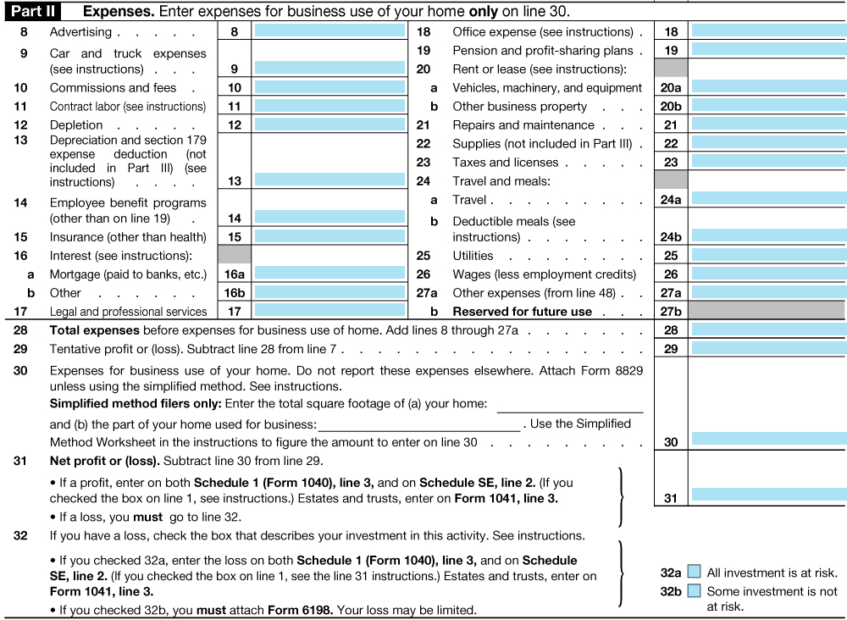
Part II – Business Expenses
20+ expense categories
Examples:
Advertising
Car/truck expenses
Contract labor
Supplies
Utilities
Line 31: Net profit (Line 7 minus Line 30)
Schedule C – Breaking Down Part II
Documentation for each expense in each category
Is this an actual expense?
Is the expense necessary for the business’s operation?

Slide 13
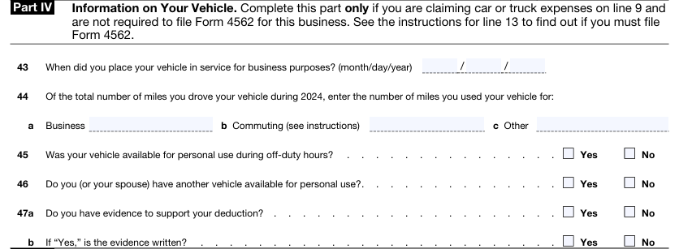
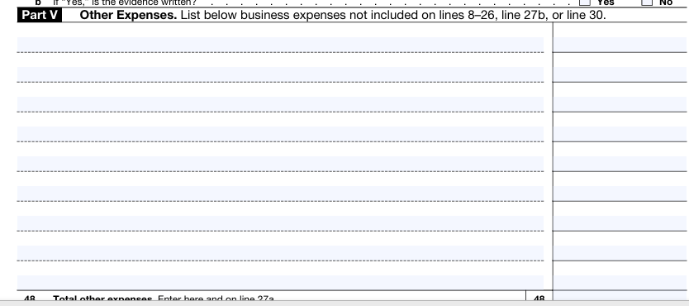
Specialized Expenses
Home Office
Vehicle
Other Expenses

Slide 14
IRS vs Child Support: Home Office Deduction
IRS Test
Exclusive and Regular Use
Space must be used exclusively and regularly for business.
Principal Place of Business
Must be primary business location OR used to meet clients.
Deductible Expenses
Direct expenses (office-only).
Indirect expenses (prorated: utilities, mortgage, insurance).
Calculation Methods
Regular Method: % of home used × total expenses.
Simplified Method: $5 per sq ft, up to 300 sq ft ($1,500 max deduction).
Child Support
Was the expense actually incurred?
Is there a cost tied directly to the business’s use of the home?
Example: If the parent owns the home outright and has no mortgage or extra utilities, the deduction for tax purposes may be paper only
If there’s no actual cash flow impact → Generally NOT deductible for child support purposes.

Slide 15
IRS vs Child Support: Vehicle Expense
IRS Test
Two methods:
Standard Mileage ($0.67/mile in 2024)
Actual Expense (fuel, repairs, insurance, etc.)
Must track:
Business vs. personal use
Mileage logs
Child Support
Is the expense an actual expense necessary for the business to operate?
Would this vehicle expense occurred whether the business existed or not? Eg. Use of personal vehicle for driving for Lyft.
Increase of vehicle insurance due to business is a valid business expense.
Determine personal use versus business use by looking at the mileage logs
Proportion actual vehicle expenses by % of personal use versus % of business use

Slide 16
Other Expenses
Other Expenses
Child Support
Often used to hide
Common entries:
Cell phone & internet
Meals & entertainment
Gifts, software, business subscriptions
Red flags: vague labels, large totals, no receipts, payments to family or shell companies
Apportion based on business use versus personal use
Are the expenses necessary for the operation of the business?
Do these expenses reduce the business’s cash flow?

Slide 17
IRS vs Child Support: Depreciation
IRS
Depreciation spreads the cost of capital assets over time.
- Accelerated depreciation (Section 179) allows larger deductions in early years.
- Depreciation (including accelerated) reduces taxable income but does not reflect cash spent.
Child Support
Child support focuses on real cash flow, not tax strategies.
Depreciation, whether normal or accelerated, is generally disallowed.
Depreciation does not impact the business’s cash flow.

Slide 18
Child Support and the Gig Economy
Gig Workers and Self-Employment
App-based, freelance, and side hustle income
Common platforms: Uber, Lyft, Door Dash, Instacart, Upwork, Etsy, Amazon, Airbnb
Often classified as independent contractors
Income reported via 1099-NEC or 1099-K
The web-based platform may provide break down of income and business costs for the Gig worker

Slide 19
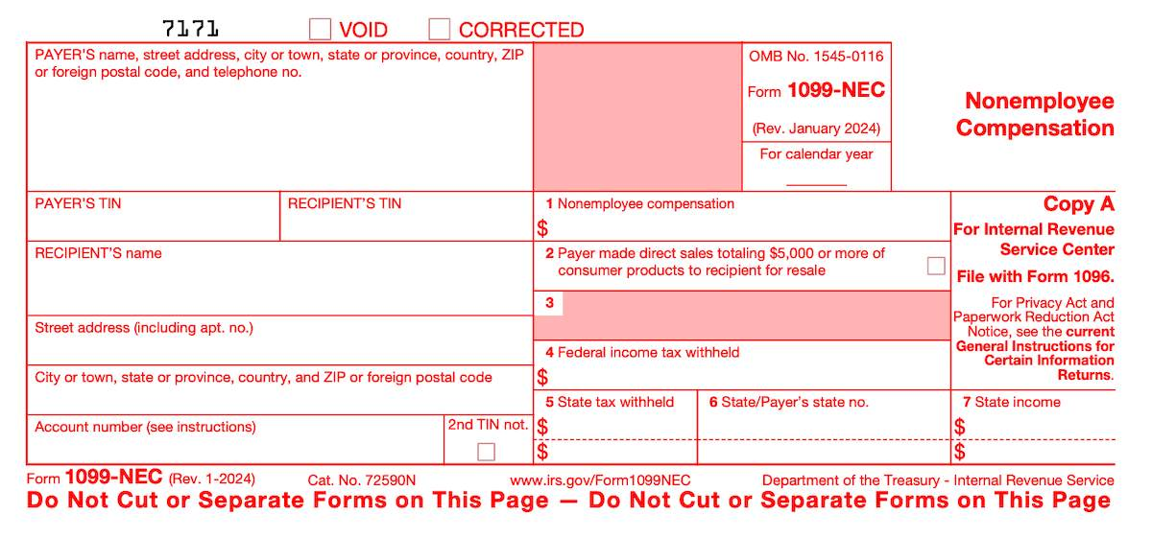
Child Support and the Gig Economy Form 1099-NEC
Form 1099-NEC
Nonemployee Compensation
(formerly reported on 1099-MISC)
Nonemployee compensation totals $600 or more in a year
Fees, benefits, commissions, prizes, and awards for services performed
Freelance and gig workers (Uber, Lyft, Instacart)
Received by January 31st each year

Slide 20
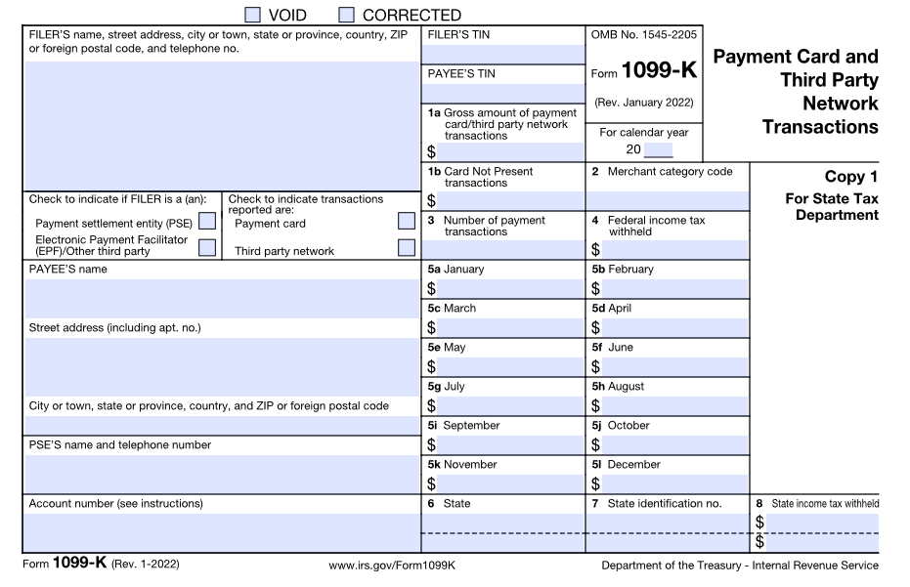
Child Support and the Gig Economy Form 1099 K
Form 1099-K
1099-K = Payment card and Third-Party Network Transactions
Card payments/transactions from online platforms, apps, or payment card processors totals $2500 or more in a year for 2025 (2024 = over $5000; 2026 on = $600)
Independent contractors report this income on Schedule C (Form 1040), Line 1
Etsy, eBay, Poshmark, PayPal, or Venmo
Received by January 31st each year

Slide 21
Commingling of Business and Personal Funds
✅ Separate accounts and documented transactions.
❌ Red flags include:
- Single mixed-use account
- Cash deposits without documentation
- Personal expenses paid from business funds

Slide 22
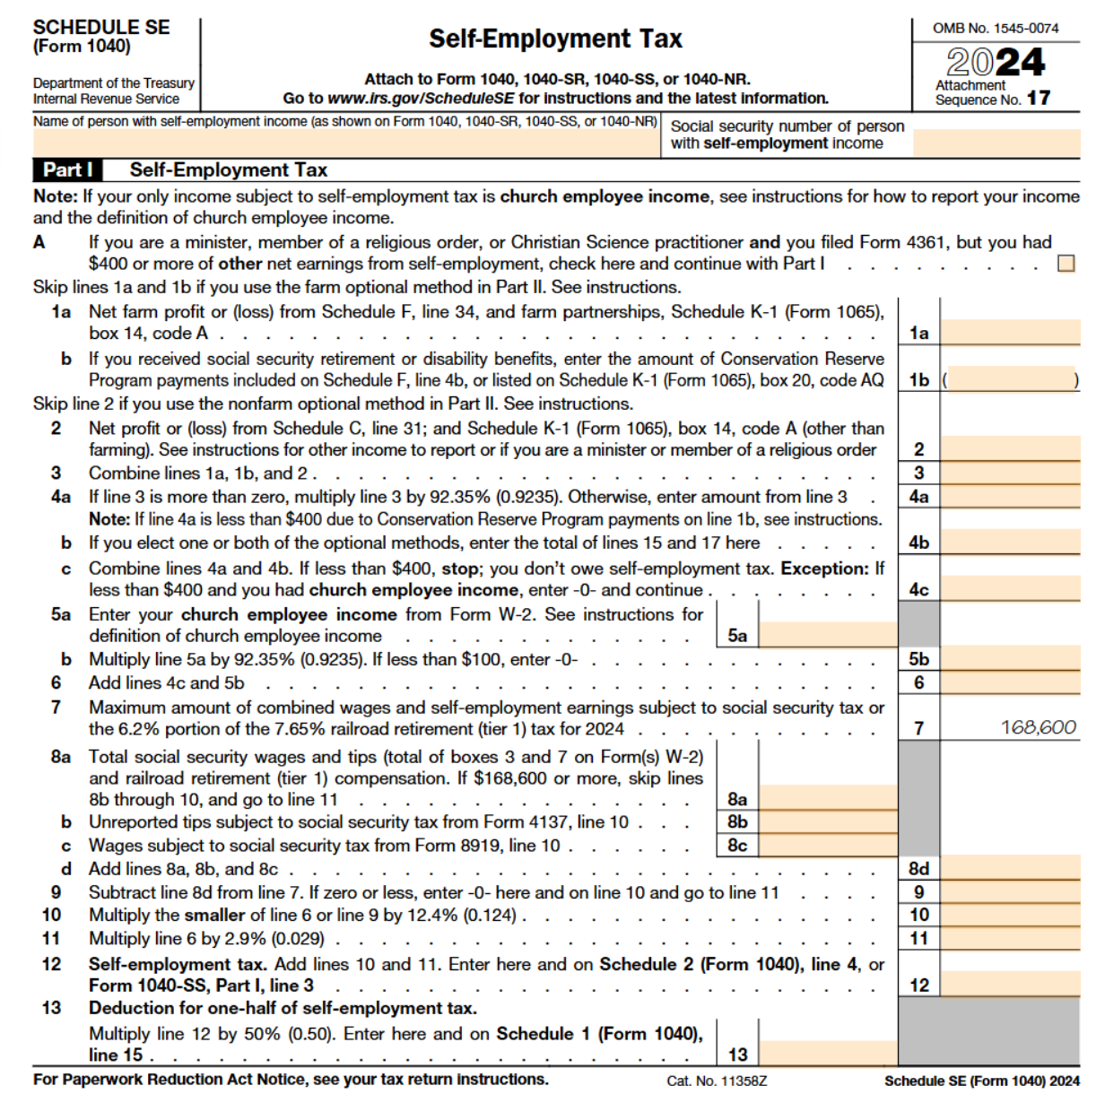
Self Employment Tax
One-half of any self-employment tax paid shall be deducted from gross income.
Virginia Code § 20-108.2 (C)
✅ What is Self-Employment Tax?
Covers Social Security and Medicare taxes for self-employed individuals.
Paid in addition to income taxes.
Rate is 15.3% (12.4% Social Security + 2.9% Medicare).

Slide 23
Income & Lifestyle Mismatch
- Compare reported income to lifestyle (housing, vehicles, vacations).
- If lifestyle exceeds reported income, consider imputation or further inquiry.

Slide 24
Summary — Self-Employment and Child Support
✅ Child Support ≠ IRS Tax Rules
Child support focuses on true cash flow, not paper deductions.
IRS deductions like depreciation are generally disallowed.
✅ Reasonable Business Expense Test Applies
Only necessary, reasonable, and actually incurred business expenses should reduce income.
Parent claiming deductions bears the burden of proof.
✅ Specialized Expenses Require Scrutiny
Home office, vehicle, and 'other' expenses (like meals and subscriptions) must meet strict standards.
✅ Beware of Red Flags
Commingled funds and lifestyle mismatches are red flags.
✅ Gig Income
Web-Based Platforms provide income and expense information
Gig workers – Form 1099-NEC
Gig Sellers – Form 1099-K
🎯 Bottom Line: Real cash flow matters most.

Slide 25
Test Your Knowledge

Slide 26
Question 1
Which of the following best describes how depreciation is treated when calculating income for child support purposes?
It is always deductible because it reduces taxable income.
It is deductible only if the parent can show the asset was used exclusively for business.
It is generally disallowed because it does not reflect actual cash spent.
It is always allowed as long as it is deducted on IRS Schedule C.
Which of the following best describes how depreciation is treated when calculating income for child support purposes?

Slide 27
Question 1
The expense must be listed on the parent’s IRS tax return.
The expense must be reasonable, necessary for the business, and actually reduces cash flow.
The expense must have been approved by a tax accountant.
Any claimed business expense is automatically allowed if it is under $1,000.
When reviewing a self-employed parent's expenses for child support purposes, which of the following is the correct standard for allowing a deduction?

Slide 28
Question 1
Form 1099-NEC, because they are nonemployee contractors paid for services.
Form 1099-K, because all app-based platforms issue this form.
Form W-2, because gig workers are treated as employees.
No form is issued — gig income is not reported for taxes.
A self-employed parent drives for a rideshare company and delivers food through an app. Which tax form will they most likely receive to report their income from these activities?

