Slide 1
How to Write a Mediated Agreement
Including Step-by-Step Guide for Completing the DC-631 Mediator's Agreement

Slide 2
Overview
Mediation Agreement Statutory Requirements
Unitary v. Non-Unitary Support orders
Arrearages
Payments
Health Insurance Costs
Unreimbursed Medical Expenses
Unreimbursed Pregnancy Costs
Overages
DC-631

Slide 3
Mediated Agreement Statutory Requirements
The guidelines computations and any reasons for deviation shall be incorporated in any written agreement by the parties. § 8.01-581.24
Although not required in the mediation agreement itself, all child support orders, including ones that incorporate a mediated agreement must contain the requirements set out in § 20-60.3.
Agreement should at least provide the following:
Names, date of birth and last four digits of each child to whom a duty of support is owed as well as the parent.
The monthly amount of support and the effective date.
Order for healthcare coverage
How unreimbursed medical costs to be paid
Establish arrearage and how to be repaid
Establish Credits and repayment of credits
Wage withholding provision or agreement not do wage withholdings
The guideline worksheet should be incorporated into the agreement and deviations should be set forth in the agreement

Slide 4
Unitary Order
Single amount for all children together
The total support amount is not broken down per child.
One lump sum amount covers all of the children combined.
If one child emancipates (ages out or otherwise stops qualifying), the total amount remains unchanged until modified by court order or agreement.
If no Separate modification or recalculation is requested, the child support remains the same, possibly creating a windfall for the custodial parent.
Example:
3 children → $1,500 total → stays $1,500 unless modified, even if one child emancipates.
Burden is on the noncustodial parent to seek a change in support.

Slide 5
Non-Unitary Order
Separate monthly support amount is assigned per child.
The monthly support amount is broken down per child.
One lump sum amount covers all of the children combined.
When a child emancipates, the obligation for that child’s portion automatically ends, and the support order amount decreases accordingly (without needing a modification).
If no Separate modification or recalculation is requested, the child support automatically is reduced, possibly creating a windfall for the noncustodial parent..
Example:
Child A → $500 Child B → $500 Child C → $500 Total → $1,500
When Child A emancipates → support automatically drops to $1,000.
Burden is on the custodial parent to seek a change in support.

Slide 6
Unitary v. Nonunitary Support

Slide 7
Arrearages
If arrears are owing and are not addressed in the agreement / consent order, it’s a strong chance they will be lost!!!!

Slide 8
Retroactive Arrears Effective Date
Initial Petitions: The date the support petition is filed with the court. Look for the date stamp.
Modifications: The date the non-requesting party is served with support order.
Were there prior arrears that need to be included?
Set forth the monthly repayment on the arrears in the agreement in addition to the current monthly child support that is due.
If the arrears includes principal and interest, then include a break down of each

Slide 9
Health Insurance Premium Costs
Since Health Insurance Premium Costs are considered in the guidelines and can be paid by either party, they should be addressed in the mediation agreement.
Provide the Parent who is responsible for the cost
Health Insurance Policy Information: At least the name of the insurance company
Eg. Mother provides health insurance for the children and Father provides dental and vision. Then indicate the specifics in the agreement.
In the event, both parents agree to carry health insurance on the children, with one insurance being primary and one being secondary, then document this into the agreement.
In the event, the noncustodial parent fails to provide the health insurance, then the custodial parent will have option to file a show cause against the noncustodial parent for failure to provide health insurance.

Slide 10
Daycare Costs
If the parents agree that the non-custodial parent shall pay the daycare provider directly, provide the details in the agreement.
In the event, the noncustodial parent fails to provide the daycare cost, then the custodial parent will have option to file a show cause against the noncustodial parent for failure to provide the daycare cost as well as seek a modification.

Slide 11
Unreimbursed Medical Cost
Medical Cost not covered by insurance (Cash Medical Support) should be addressed in the agreement.
Provide that the parents pay in accordance to their income shares, any reasonable and necessary unreimbursed medical or dental expenses.
Medical or dental expenses shall include but not be limited to eyeglasses, prescription medication, prosthetics, orthodontics, and mental health or developmental disabilities services, including but not limited to services provided by a social worker, psychologist, psychiatrist, counselor, or therapist.
In the event, a parent fails to provide the unreimbursed medical, then the aggrieved parent will have the ability to file a show cause against the parent for failure to pay unreimbursed medical. The aggrieved party must give the parent copies of the medical bills and at least 30 days to make arrangements before filing a show cause.

Slide 12
Unreimbursed Pregnancy Costs
In the event that the initial petition for the establishment of parentage is commenced within six months of the live birth of a child, the judgment or order shall, except for good cause shown or as otherwise agreed to by the parties, apportion between the legal parents, in proportion to the legal parents' gross incomes (income shares)... (i) the mother's unreimbursed pregnancy and delivery expenses and (ii) those reasonable expenses incurred by either parent for the benefit of the child prior to the birth of the child.
§ 20-49.8

Slide 13
Overages
If support overages exist, (i) to whom an overage is owed and the amount of the overage, (ii) the period of time for which such overage is calculated, and (iii) how such overage is to be paid - § 20-60.3 (9)(a).
Overages typically occur in motions for decrease.

Slide 14
Overages
John files for a decrease of support. The sheriff serves the motion on Jill on February 1, 2025. The current support order requires John to pay $1000 per month. At the mediation on June 20, 2025, the support is reduced to $500 per month. John owes -0- arrears, through June 2025. He is entitled to a $500 per month credit from February through June (5 months), totaling $2500 credit.

Slide 15
Overages
Chesterfield Method
Depending on the size of the over payment divide the total over payment amount by 3, 10 or 12 months and reduce the amount the payor owes by this number. $0 support for a month or two is not a good option.
“Both parties agree that John overpaid Jill $2500 between the time period of February 1, 2025 through June 20, 2025. The parties agree that John shall pay $291.67 per month child support beginning July, 1, 2025 through June 30, 2026. Payments between July 1, 2025 through June 30, 2026 shall be made on the 1st day of each month. The parties agree John shall pay $500 per month child support payments beginning July 1, 2026. Subsequent payments are due on the 1st day of each month thereafter.” ($2500 / 12 = 208.33 // $500 – 208.33 = $291.67)

Slide 16
Virginia Code § 20-60.3 — Key Requirements for Agreements
Virginia Code § 20-60.3 requires that every support order include essential provisions. The DC-631 Mediated Agreement form is structured to ensure these statutory mandates are met.
Key Required Contents per § 20-60.3:
- Identification of the parties and children covered by the order.
- Amount and timing of support obligations.
- Health care coverage requirements, including who must provide insurance.
- Terms for handling arrearages and overages.
- License suspension notice for noncompliance.
- Provisions for wage withholding and payment through DCSE when applicable.
- Duration of the support obligation, including statutory termination or extension scenarios.
By completing DC-631 correctly, mediators ensure agreements comply with § 20-60.3 and are enforceable in court.

Slide 17
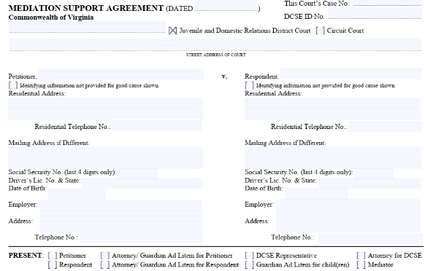
DC-631 Mediation Support Agreement
Match
- Court name and locality must match filing location
Verify
- Verify case number, DCSE case number, parties' names, DOBs, SSNs
Include
- Include employer information for wage withholding. Identify who was present at the mediation

Slide 18
Warning do not do the following:
x
x
x
This involves cases where adult children are brought before the court to pay support to their parents; the parents are in dire circumstances. This provision has nothing to do with child or spousal support cases.

Slide 19
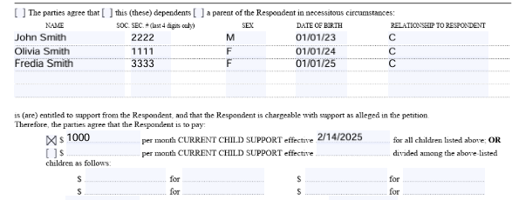
Support Amounts Unitary Award
- Insert monthly support obligation
- Choose Unitary (lump sum) or Nonunitary (per child)
- Insert effective date accurately
Eg. Of Unitary Award

Slide 20
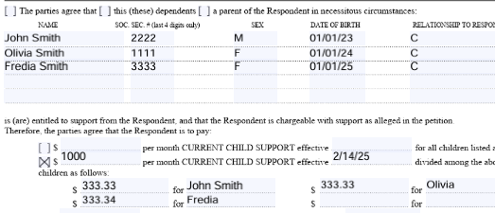
Support Amounts Non-Unitary Award
- Insert monthly support obligation
- Choose Unitary (lump sum) or Nonunitary (per child)
- Insert effective date accurately
Eg. Of Non-Unitary Award

Slide 21
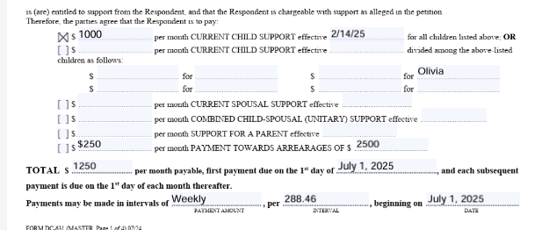
Support Amounts
Warning: Do not enter Info
x
x
Insert monthly support obligation and the order’s effective date.
Insert monthly payment toward the arrears along with the total arrears. Arrears specifics will be addressed on the next page.
Insert the total monthly support amount and first payment date.
Interval date is optional.
Don’t forget to check the boxes.
Warning: This provision in yellow orders the children to pay the parents child support.

Slide 22
Support Amounts
Warning: Do not enter Info
x
x
Insert monthly support obligation and the order’s effective date.
Insert monthly payment toward the arrears along with the total arrears. Arrears specifics will be addressed on the next page.
Insert the total monthly support amount and first payment date.
Interval date is optional. (DCSE does not consider the payment last until the last day of the month the support is due.
Don’t forget to check the boxes.
Warning: This provision in yellow orders the children to pay the parents child support.

Slide 23
Notice Provision & Disability Provision
x
x
The notice includes details regarding emancipation, support termination, and repayment of arrears.
Exercise caution—if the previous order prolonged child support beyond the point of emancipation, the agreement must explicitly reaffirm this extension; otherwise, it may be forfeited.
The second section pertains to children with disabilities. Unless there is mutual consent to the contrary, the disability must have arisen prior to the child's emancipation. § 20-60.3.

Slide 24
Arrearages: No arrears exist
x
x

Slide 25
Arrearages: Child Support arrears exist without interest
x
x
x

Slide 26
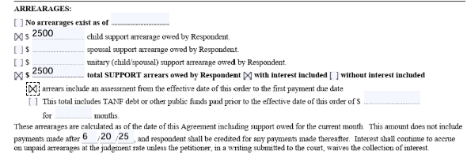
Arrearages: Child Support arrears exist with interest Provide a break down

Slide 27
Credit Balances:

Slide 28
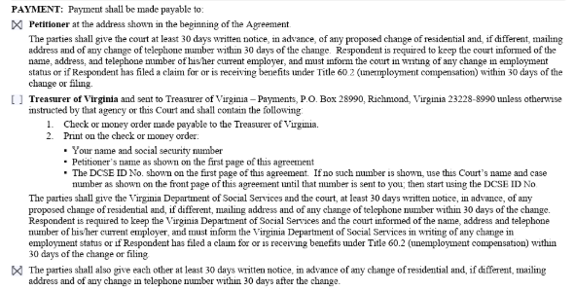
Payments: Directly to the Petitioner

Slide 29
Payments: Directly to the Petitioner with Court Ordered Wage Withholding – Pass-Through Case

Slide 30
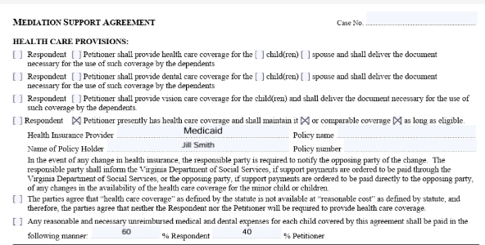
Health Care Provisions: Medicaid Example Health Insurance & Unreimbursed Medical Costs
x

Slide 31
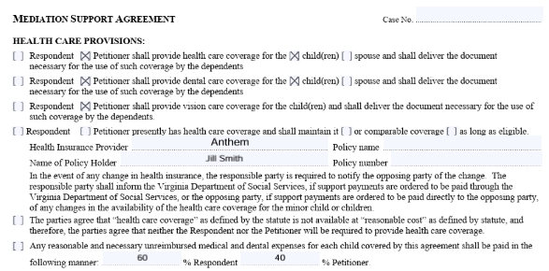
Health Care Provisions: Health Insurance & Unreimbursed Medical Costs
x

Slide 32
Tax Dependency Exemption and Credits

Slide 33
Guideline Information: No Deviation

Slide 34
Guideline Information: Deviation

Slide 35
Signatures

Slide 36
Final Summary — Importance of Drafting Mediated Agreements Carefully
✅ Agreements vs Orders
- Virginia Code § 20-60.3 applies to orders, not agreements.
- BUT, if the agreement is incorporated into a court order, best practice to incorporate § 20-60.3 provisions
- All agreement terms should be set forth in detail so that they are enforceable
✅ Addressing Arrearages
- If arrears are left out, they may be lost forever once the order is entered.
- Always state the arrears amount and repayment terms in the agreement.
✅ Best Practices
- Draft agreements assuming they will become orders.
- Cover all required issues: support amount, arrears, overages, health care, deviations.
- A complete agreement ensures enforceability and avoids future disputes.

Slide 37
Test Your Knowledge

Slide 38
Question 1
Why is it critical to include arrears in a mediated support agreement?
Because arrears will automatically carry forward even if omitted.
Because DCSE will add arrears later even if not mentioned.
Because if omitted, arrears may be lost forever once the agreement is incorporated into the order.
Because the parties can simply modify the order later to add arrears.

Slide 39
Question 2
Who has the burden file for a modification on a non-unitary support order?
The Custodial Parent has the burden to file to change the ordered amount.
The Noncustodial Parent has the burden to file to change the ordered amount.
The NonParent Caretaker has the burden to file to change the ordered amount.
DCSE has the burden to file to change the ordered amount.

Slide 40
Question 3
In a pass-through case, who is the support ordered to be paid to?
The agreement should reflect that the support should be paid to DCSE.
The agreement should reflect that the support should be paid to the Treasurer of Virginia.
The agreement should reflect that the support should be paid to the Court.
The agreement should reflect that the support should be paid to the Custodial Parent.

